Slide 1

PWC FORAGE INTERNSHIP
Task 3 – Predictive Health Care with large dataset

Slide 2
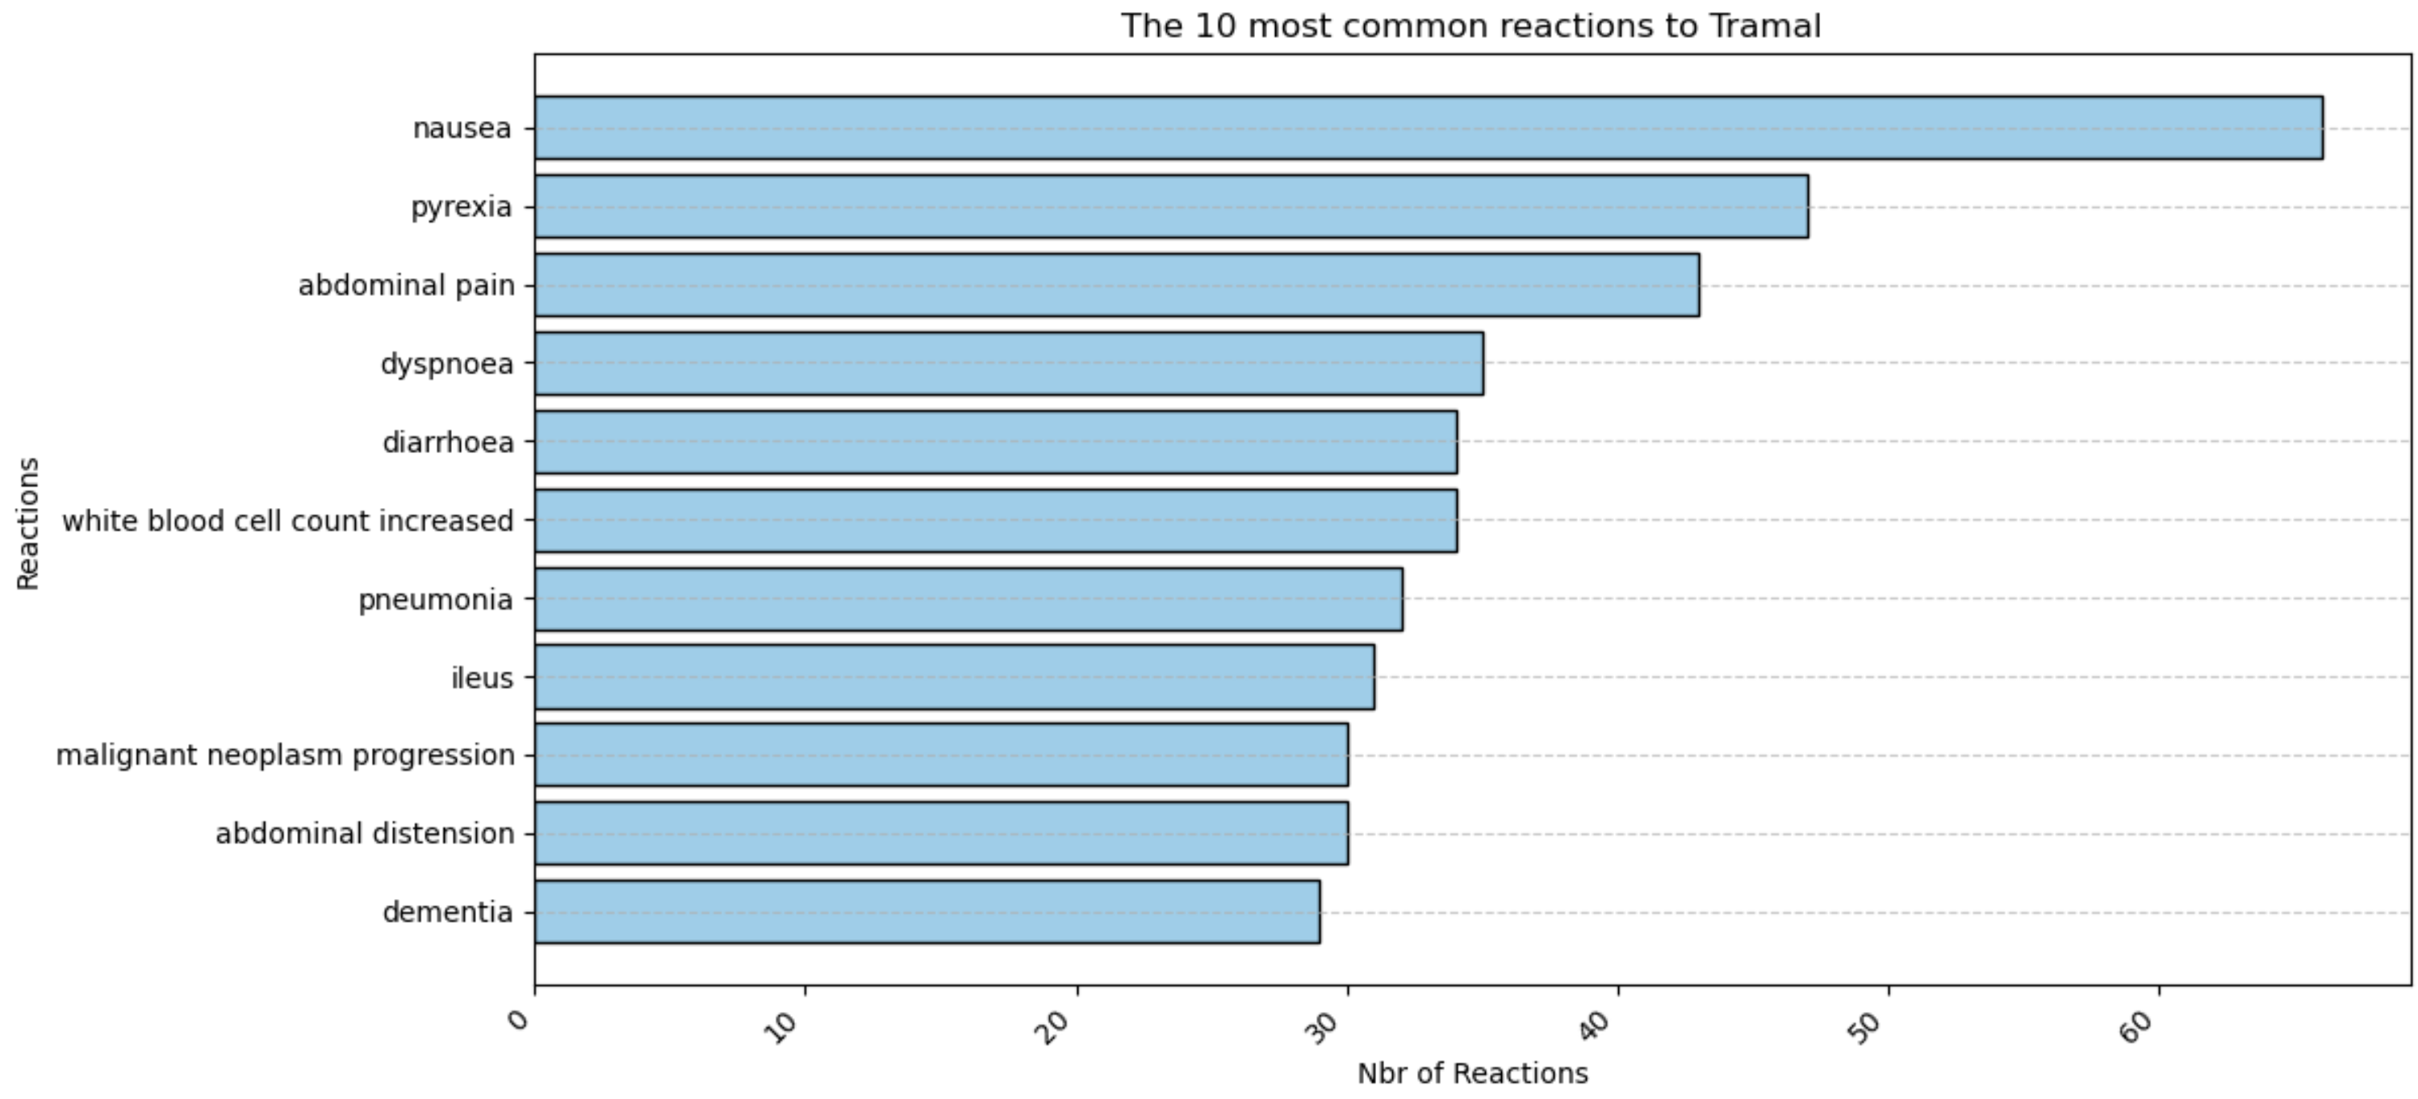
10 Most Common Reactions To Tramal

Slide 3
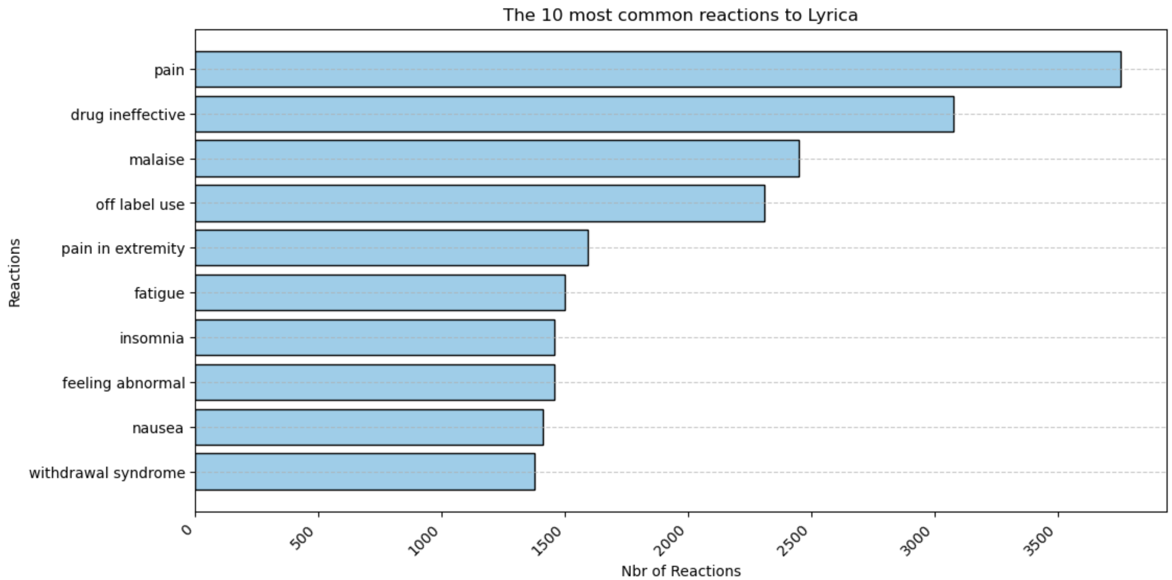
10 Most Common Reactions To Lyrica

Slide 4
Comparaisons between the Tramal and Lyrica
→ Lyrica is prescribed more often than Tramal; therefore, more side effects are recorded for Lyrica compared to Tramal (around 6,000 to 3,000 for Lyrica, compared to around 60 to 30 for Tramal).
 | Comparaison between Tramal and Lyrica
1 | Lyrica has a higher likelihood of causing side effects compared to Tramal (see next slide)
2 | Lyrica does not seem to be very effective for pain management; the drug appears to be inefficient.
3 | Tramal has more 'serious' side effects, including nausea, pyrexia, and abdominal pain.

Slide 5
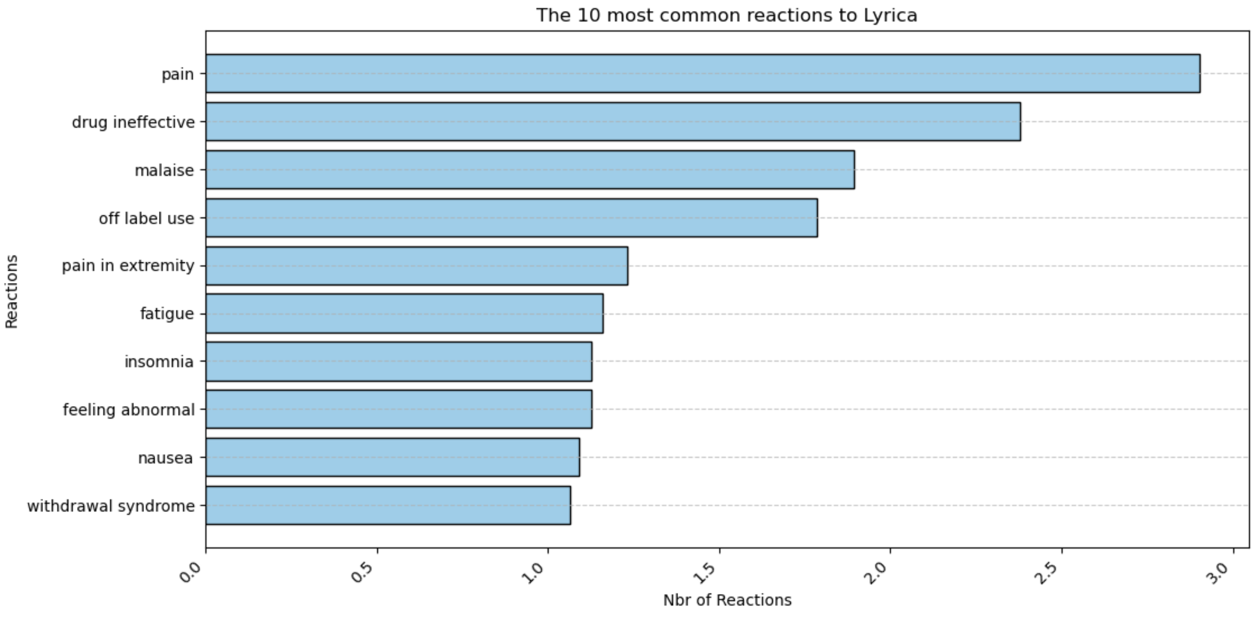
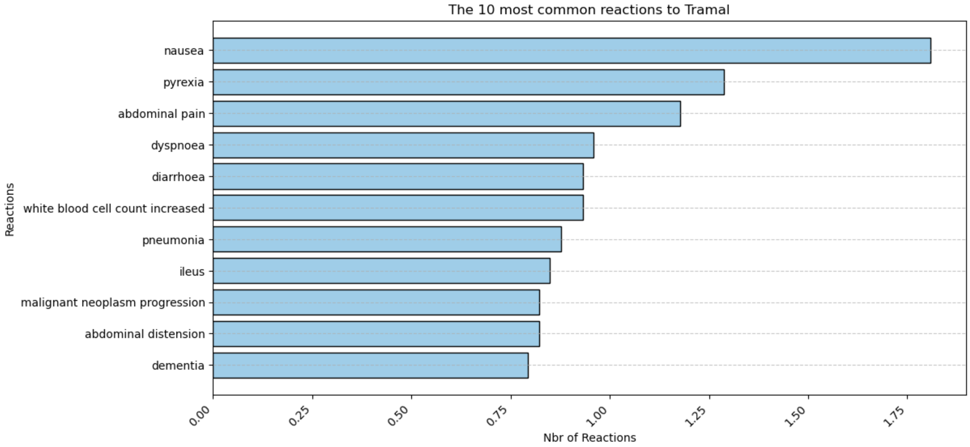
Comparison between Tramal and Lyrica in terms of the percentage of their total reactions
Lyrica has a higher percentage of side effects, ranging from 3% to 1% for the 10 most common reactions, compared to Tramal, which ranges from 1.9% to 0.8%

Slide 6
Futher investigations
1) Based on our dataset, is Tramal or Lyrica better for certain age groups than others?
2) Is Tramal or LAre there any side effects associated with the fact that the patient is taking other medications?
3) What are the long-term vs. short-term effects of these drugs?
4) Are certain adverse effects reported more frequently, and does that introduce bias into the data?
5) What yrica more effective for one gender compared to the other?
6) was the drug originally prescribed for? Do the adverse effects vary depending on the initial purpose of the prescription?

